Slide 1
General parameter-shift rule
Vu Tuan Hai
28/5/2022

Slide 2
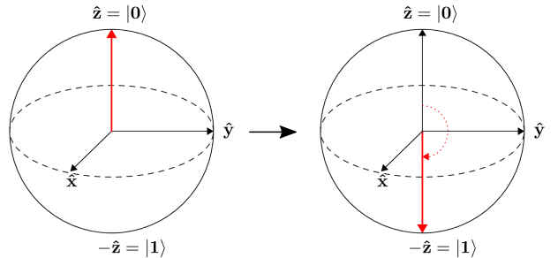
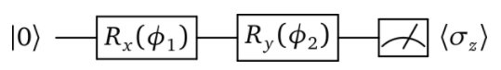
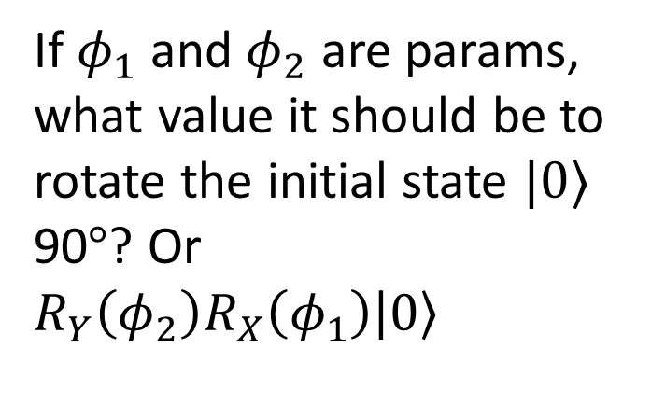
0. Problem: Rotation gate
If $φ_{1}$ and $φ_{2}$ are params, what value it should be to rotate the initial state $|0⟩$ 90$°$? Or $R_{Y}\left(φ_{2}\right)R_{X}\left(φ_{1}\right)\left|0\right\rangle$

Slide 3
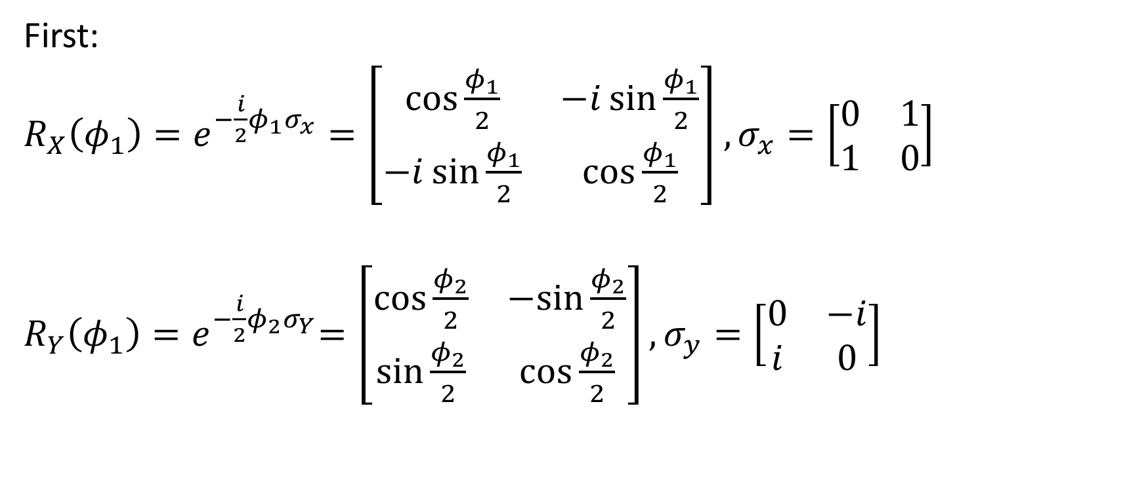
Rotation gate
First:
$R_{X}\left(φ_{1}\right)=e^{−\frac{i}{2}φ_{1}σ_{x}}=\left[\begin{matrix}\cos{\frac{φ_{1}}{2}} & −i\sin{\frac{φ_{1}}{2}} \\ −i\sin{\frac{φ_{1}}{2}} & \cos{\frac{φ_{1}}{2}}\end{matrix}\right]$ $,σ_{x}=\left[\begin{matrix}0 & 1 \\ 1 & 0\end{matrix}\right]$
$R_{Y}\left(φ_{1}\right){=e}^{−\frac{i}{2}φ_{2}σ_{Y}}=\left[\begin{matrix}\cos{\frac{φ_{2}}{2}} & −sin{\frac{φ_{2}}{2}} \\ \sin{\frac{φ_{2}}{2}} & \cos{\frac{φ_{2}}{2}}\end{matrix}\right],σ_{y}=\left[\begin{matrix}0 & −i \\ i & 0\end{matrix}\right]$

Slide 4
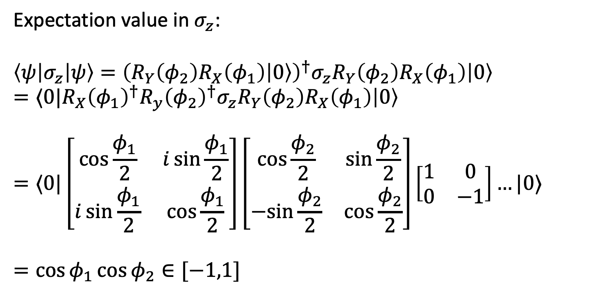
Rotation gate
Expectation value in $σ_{z}$:
$$\left\langle ψ\left|σ_{z}\right|ψ\right\rangle ={\left(R_{Y}\left(φ_{2}\right)R_{X}\left(φ_{1}\right)\left|0\right\rangle \right)}^{†}σ_{z}R_{Y}\left(φ_{2}\right)R_{X}\left(φ_{1}\right)\left|0\right\rangle$$
$$=⟨0|R_{X}{\left(φ_{1}\right)}^{†}R_{y}{\left(φ_{2}\right)}^{†}σ_{z}R_{Y}\left(φ_{2}\right)R_{X}\left(φ_{1}\right)\left|0\right\rangle$$
$$=⟨0|\left[\begin{matrix}\cos{\frac{φ_{1}}{2}} & i\sin{\frac{φ_{1}}{2}} \\ i\sin{\frac{φ_{1}}{2}} & \cos{\frac{φ_{1}}{2}}\end{matrix}\right]\left[\begin{matrix}\cos{\frac{φ_{2}}{2}} & \sin{\frac{φ_{2}}{2}} \\ −sin{\frac{φ_{2}}{2}} & \cos{\frac{φ_{2}}{2}}\end{matrix}\right]\left[\begin{matrix}1 & 0 \\ 0 & −1\end{matrix}\right]…|0⟩$$
$$=\cos{φ_{1}}\cos{φ_{2}∈[−1,1]}$$

Slide 5

Rotation gate
We want our state rotate 90 degree so $\cos{φ_{1}}\cos{φ_{2}}=−1$

Slide 6
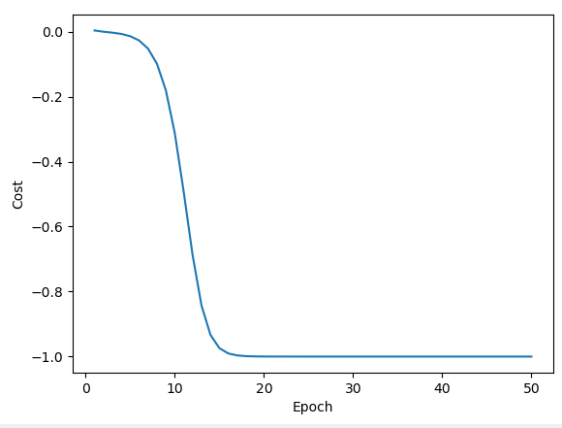
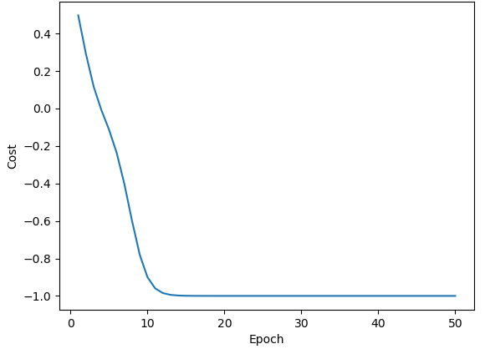


Experiments
With normal initialize for the pair $(φ_{1},φ_{2})$, 100 epoch, 0.4 learning rate, optimizer: GD, gradient by parameter – shift rule.
Init $φ$: [ 1.43609915 -1.48030143]
Init $φ$: [-0.51976105 0.66569928]
Solution: [ 2.83369713e-09 -3.14159265e+00]
Solution: [-4.44548300e-10 3.14159265e+00]

Slide 7
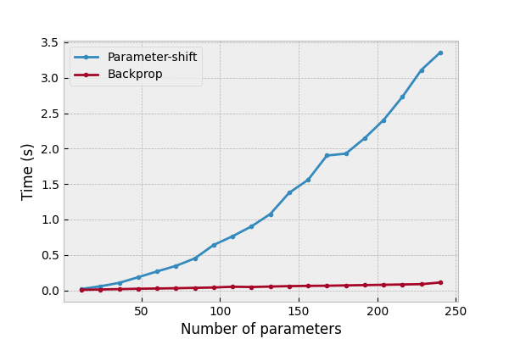

Quantum gradients
$$∂f\left(x\right)=r(f\left(x+ε\right)−f(x−ε))$$

Slide 8

1. Basic definition
Variational quantum algorithm (VQA) is a quantum-classical hybrid scheme
Update $θ$
Quantum part
Classical part
Input
Cost value

Slide 9
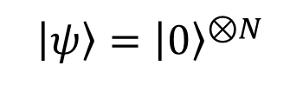
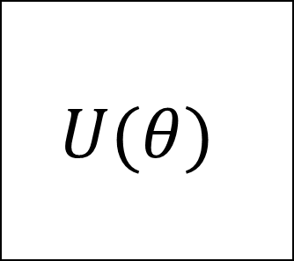
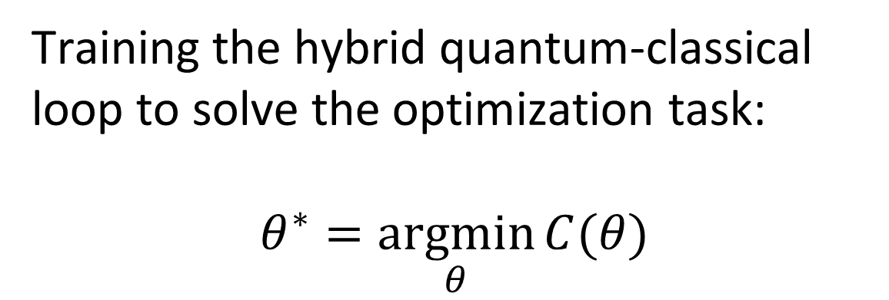
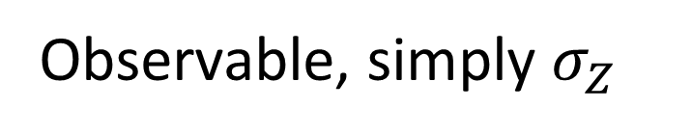

1. Basic definition
$$U(θ)$$
$$C\left(θ\right)≔⟨ψ\left|U^{†}\hat{B}U\right|ψ⟩$$
$\left|ψ\right\rangle ={\left|0\right\rangle }^{⊗N}$
Measure
Training the hybrid quantum-classical loop to solve the optimization task:
$$θ^{∗}=\underset{θ}{argmin}{C(θ)}$$
Observable, simply $σ_{Z}$

Slide 10
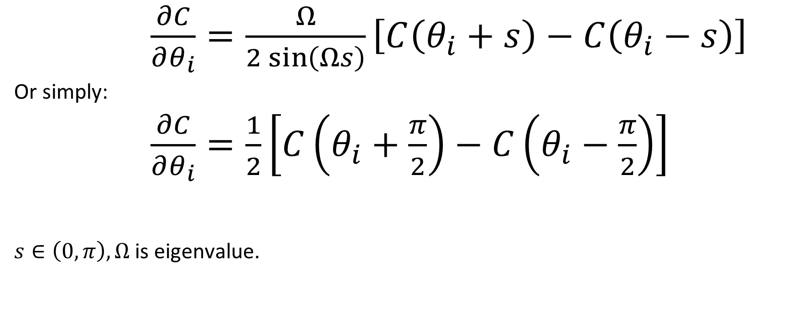


2. Parameter-shift rule
$\frac{∂C}{∂θ_{i}}=\frac{Ω}{2\sin\left(Ωs\right)}\left[C\left(θ_{i}+s\right)−C\left(θ_{i}−s\right)\right]$
Or simply:
$\frac{∂C}{∂θ_{i}}=\frac{1}{2}\left[C\left(θ_{i}+\frac{π}{2}\right)−C\left(θ_{i}−\frac{π}{2}\right)\right]$
$s∈\left(0,π\right),Ω$ is eigenvalue.
$$R_{Y}(θ)$$
$$λ=\{−1,1\}$$
Mitarai et al. (2018), and extended in Schuld et al. (2018)

Slide 11

Examples
$f\left(x\right)=\sin{x}$
$f^{′}\left(x\right)=\frac{1}{2}\left[\sin\left(x+\frac{π}{2}\right)−sin⁡(x−\frac{π}{2})\right]=\frac{1}{2}\left[\cos\left(x\right)+cos⁡(x)\right]$
$=cos⁡(x)$

Slide 12
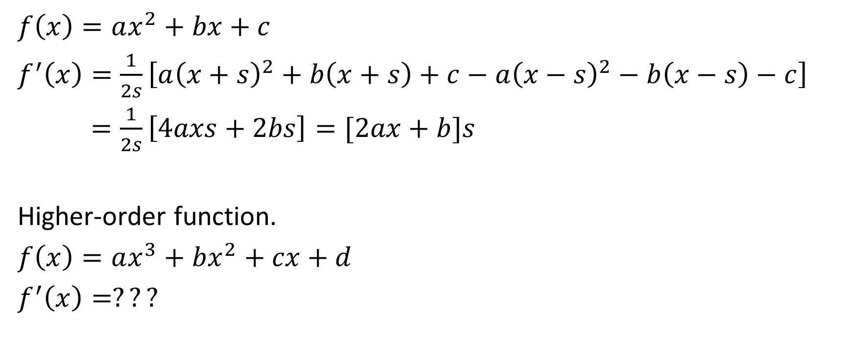
Examples
$f\left(x\right)=ax^{2}+bx+c$
$f^{′}\left(x\right)=\frac{1}{2s}\left[a{\left(x+s\right)}^{2}+b\left(x+s\right)+c−a{\left(x−s\right)}^{2}−b\left(x−s\right)−c\right]$
$=\frac{1}{2s}\left[4axs+2bs\right]=[2ax+b]s$
Higher-order function.
$f\left(x\right)=ax^{3}+bx^{2}+cx+d$
$f^{′}\left(x\right)=???$

Slide 13



2. Four – term parameter-shift rule
$\frac{∂C}{∂θ_{i}}=d_{1}\left[C\left(θ_{i}+s_{1}\right)−C\left(θ_{i}−s_{1}\right)\right]−d_{2}\left[C\left(θ_{i}+s_{2}\right)−C\left(θ_{i}−s_{2}\right)\right]$
$$R_{Y}(θ)$$
$$λ=\{−1,0,1\}$$
Kottmann (2021)

Slide 14
2. General parameter-shift rule
General parameter-shift rules for quantum gradients, Quantum, volume 6, page 677

Slide 15
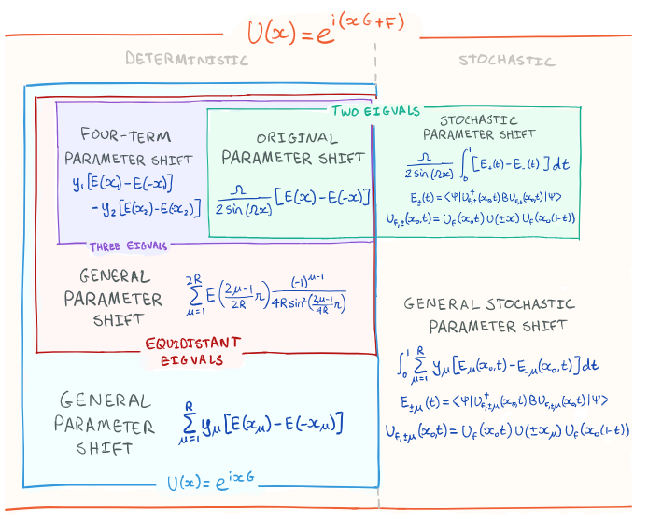

Slide 16
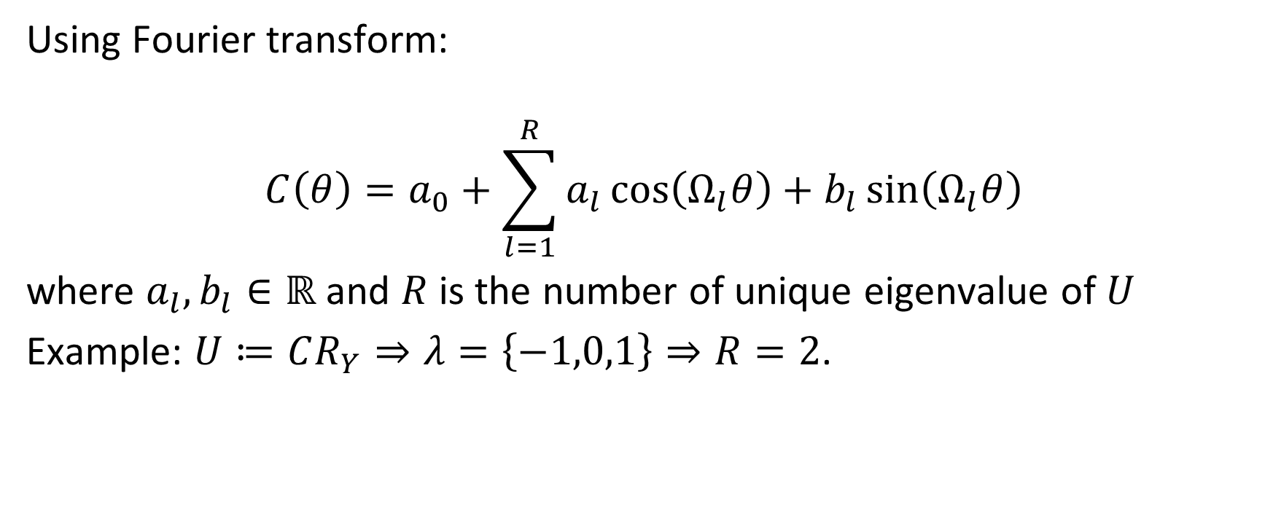
2. General parameter-shift rule
Using Fourier transform:
$$C\left(θ\right)=a_{0}+\sum_{l=1}^{R}{a_{l}\cos\left(Ω_{l}θ\right)+b_{l}\sin\left(Ω_{l}θ\right)}$$
where $a_{l},b_{l}∈ℝ$ and $R$ is the number of unique eigenvalue of $U$
Example: $U≔CR_{Y}⇒λ=\left\{−1,0,1\right\}⇒R=2$.

Slide 17
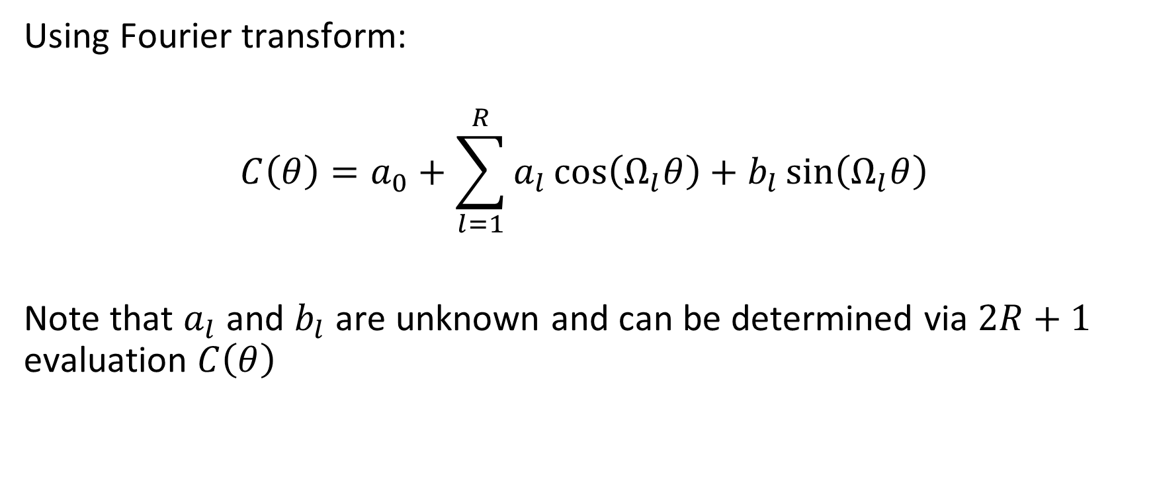
2. General parameter-shift rule
Using Fourier transform:
$$C\left(θ\right)=a_{0}+\sum_{l=1}^{R}{a_{l}\cos\left(Ω_{l}θ\right)+b_{l}\sin\left(Ω_{l}θ\right)}$$
Note that $a_{l}$ and $b_{l}$ are unknown and can be determined via $2R+1$ evaluation $C\left(θ\right)$

Slide 18

2. General parameter-shift rule
$∂C\left(θ\right)=Ω_{l}\sum_{l=1}^{R}{{−a}_{l}\sin\left(Ω_{l}θ\right)+b_{l}\cos\left(Ω_{l}θ\right)}$
Or:
$∂C\left(0\right)=\sum_{μ=1}^{R}{d_{μ}\left(C\left(θ+s_{μ}\right)−C(θ−s_{μ})\right)}$

Slide 19

3. Lagrange interpolation (developing)
$$P\left(x\right)=\sum_{i=1}^{n+1}{P\left(x_{i}\right).\prod_{j=1,j≠i}^{n+1}{(\frac{x−x_{j}}{x_{i}−x_{j}})}}$$
$$e^{−ixG}=\sum_{k=0}^{n−1}{e^{−ixλ_{k}}.\prod_{l=0,l≠k}^{n−1}{(\frac{G−λ_{l}I}{λ_{k}−λ_{l}})}}$$

Slide 20
-> Ap dụng các phương pháp bên deep learning theory principle
-> Sử dụng HMM để giải hệ phương trình tuyến tính => fully quantum

Slide 21
3. Lagrange interpolation (developing)
This approach uses less number of evaluation than general parameter-shift rule in case n = 4 and n = 5.

Slide 22
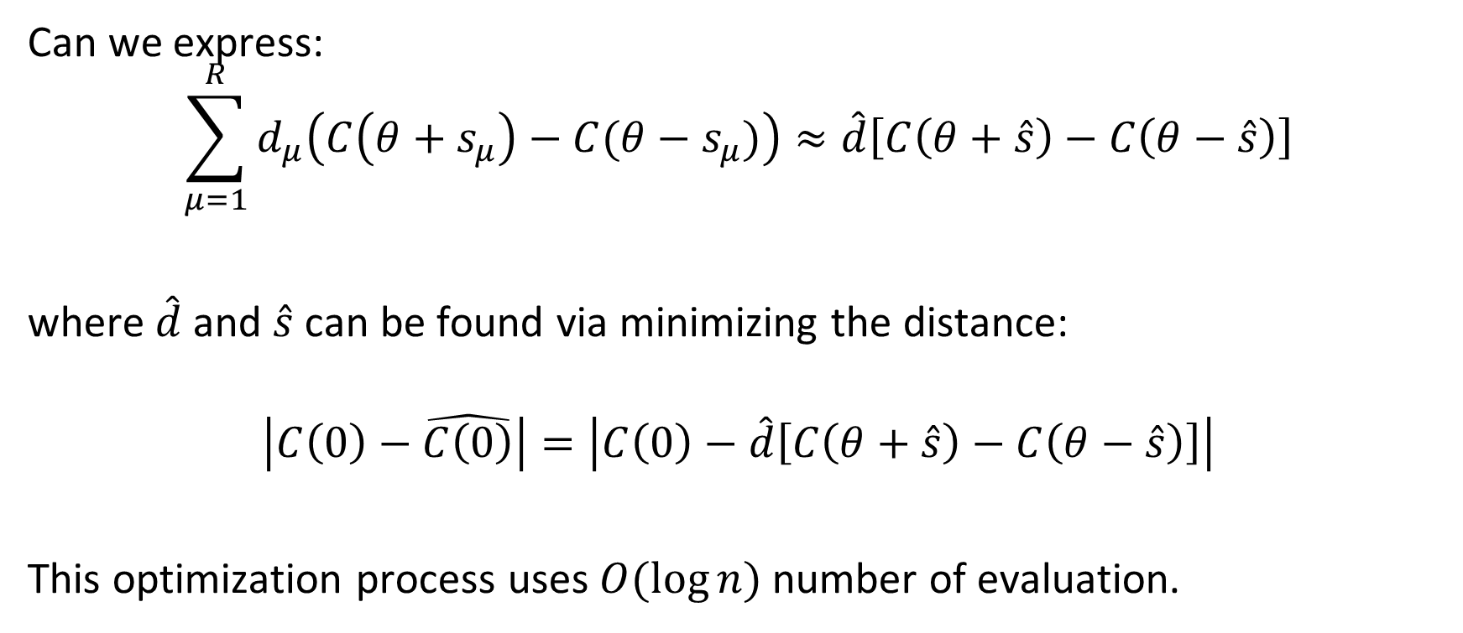
4. Pseudo parameter-shift rule
Can we express:
$$\sum_{μ=1}^{R}{d_{μ}\left(C\left(θ+s_{μ}\right)−C(θ−s_{μ})\right)}≈\hat{d}\left[C\left(θ+\hat{s}\right)−C\left(θ−\hat{s}\right)\right]$$
where $\hat{d}$and $\hat{s}$ can be found via minimizing the distance:
$$\left|C\left(0\right)−\hat{C\left(0\right)}\right|=\left|C\left(0\right)−\hat{d}\left[C\left(θ+\hat{s}\right)−C\left(θ−\hat{s}\right)\right]\right|$$
This optimization process uses $O(\log{n})$ number of evaluation.

